Slide 1

OLMS - AN ONLINE LIBRARY MANAGEMENT SYSTEM
A. ABHISHEK - 01FB16ECS001
A. VIVEK REDDY - 01FB16ECS002
AKSHAY BHARADWAJ - 01FB16ECS047

Slide 2







TECHNOLOGY USED

Slide 3
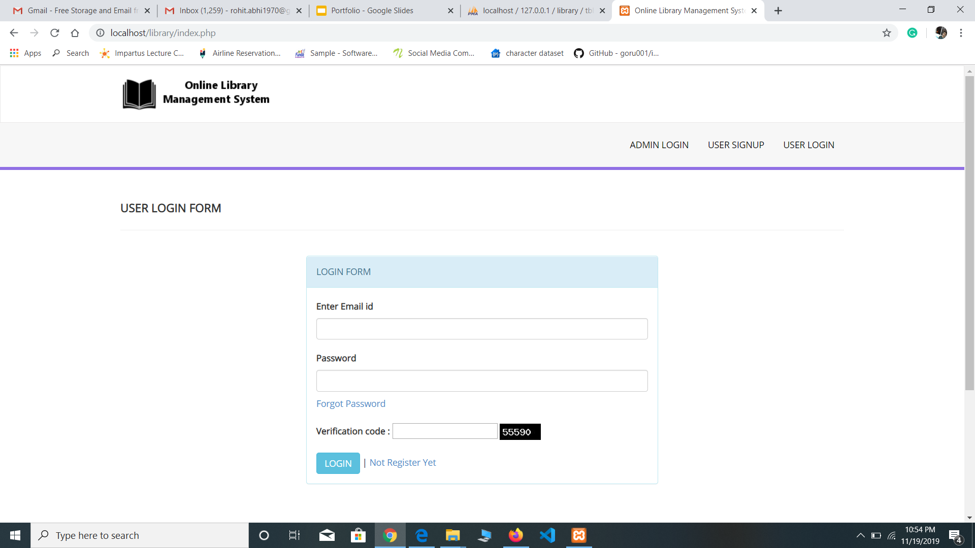
OLMS - components
AJAX patterns
Multistage Downloading
Hidden frames
COMET(Reverse AJAX)
Server Sent Events(Chat app)
Frameworks Used
Angular JS
Bootstrap & JQUERY (UI)
Intelligent Component
Recommendation System
MySQL for storing user/customer data.

Slide 4
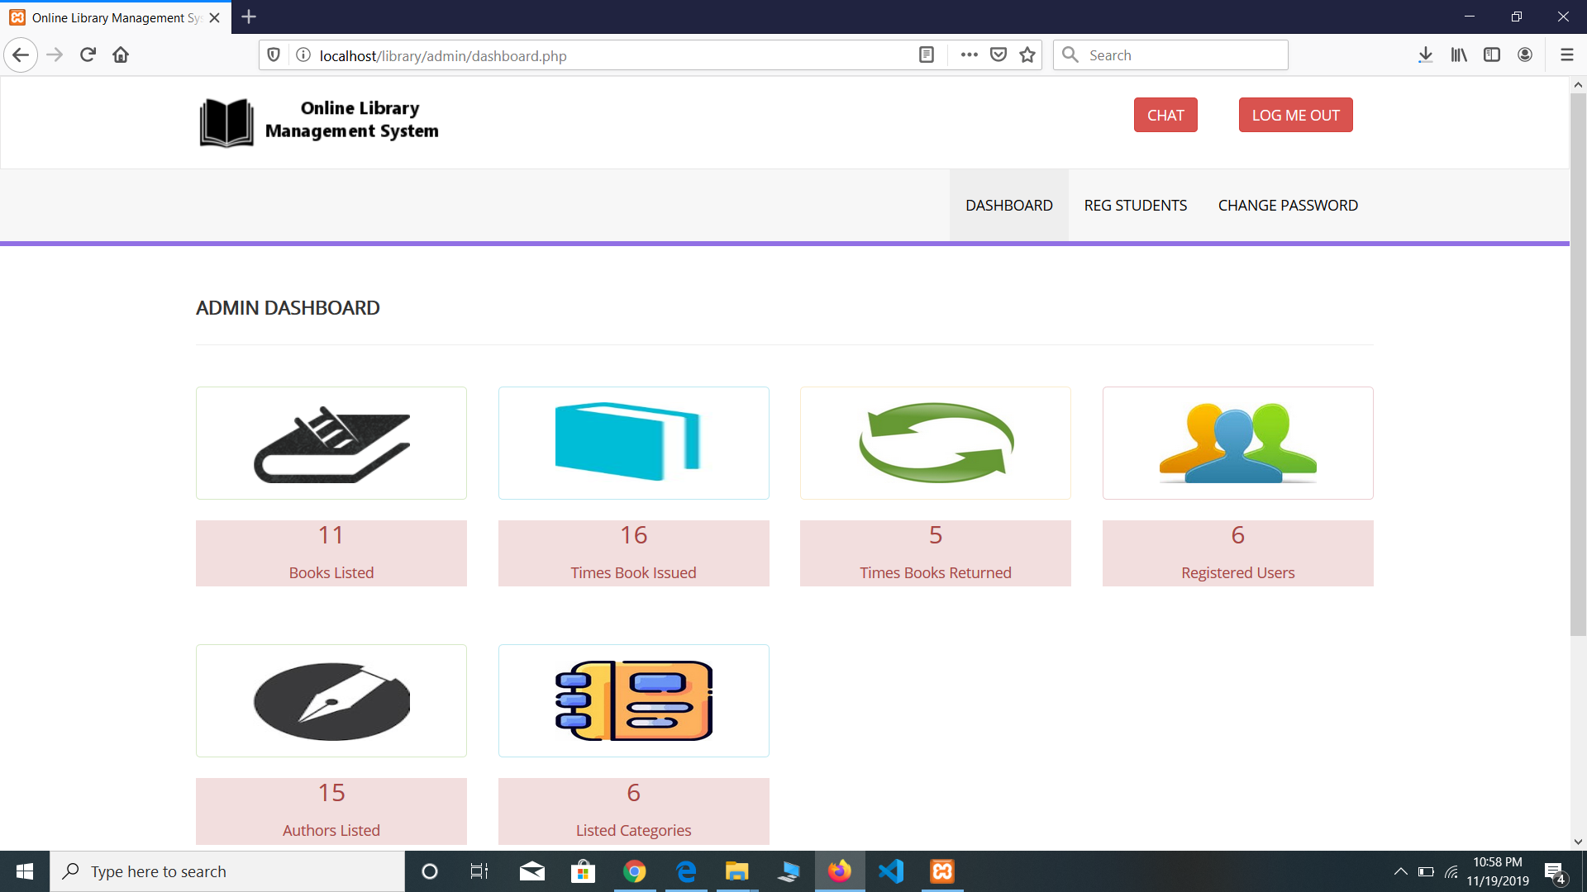
AJAX PATTERN
Multi Stage Download
At first loaded page contains a very simple page with minimal content
Within a few seconds, the page jumps to life as content from several different locations is pulled in and displayed.
The images and the logos for each category are loaded using multi stage download.

Slide 5
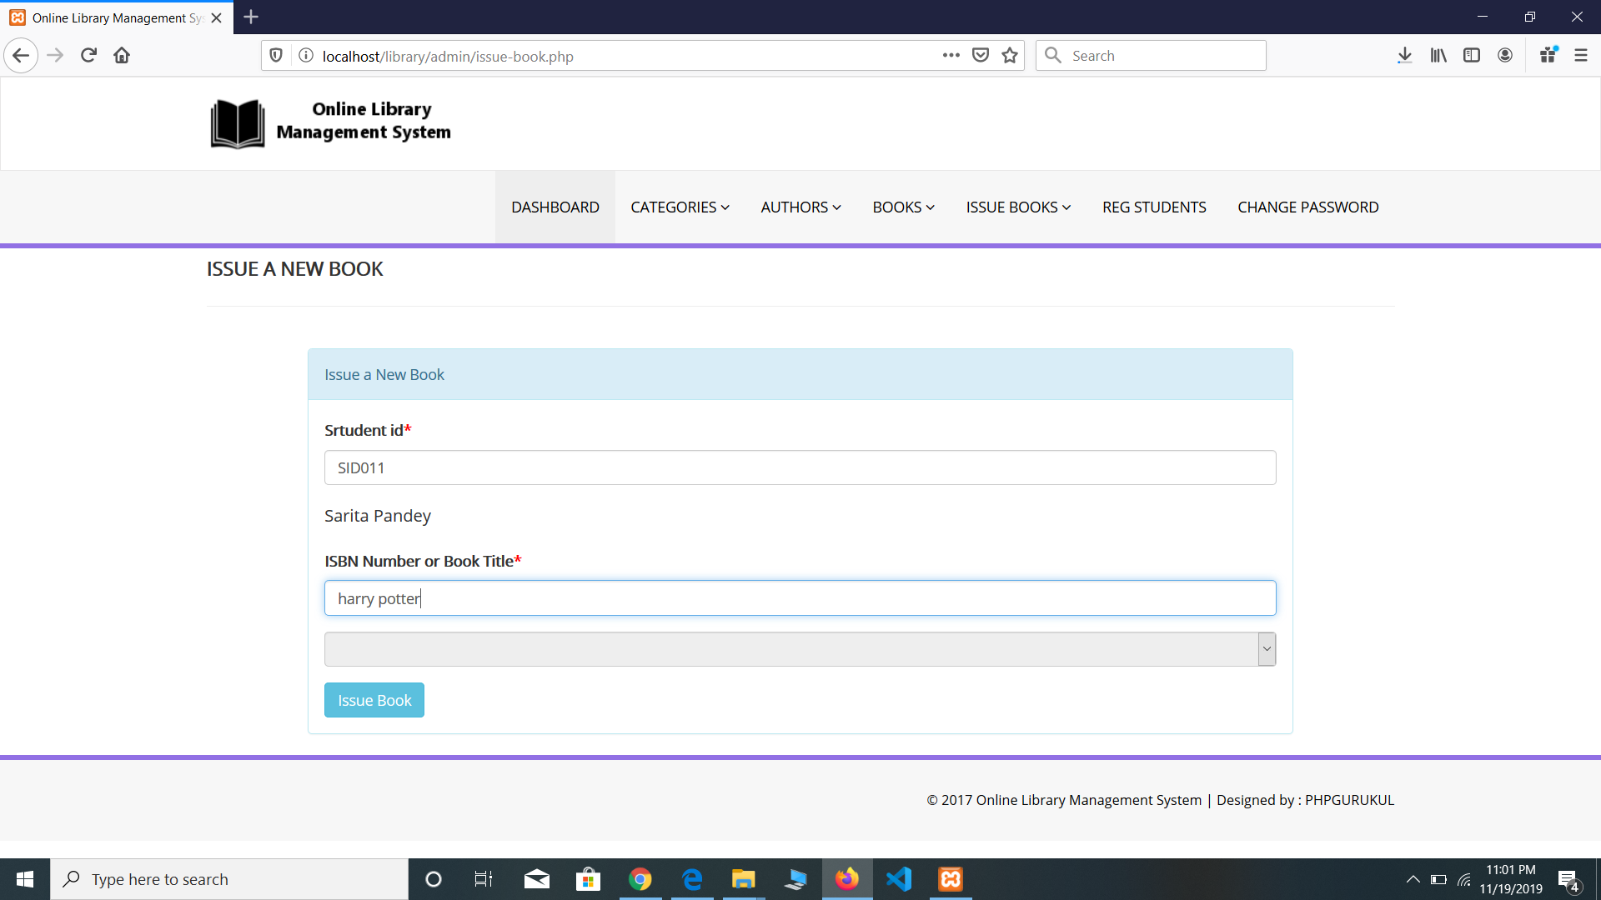
Hidden Frames
We used hidden frames to show whether a student is active or not.
If student id is valid and active the we make the hidden frame visible with student Name as value.
Otherwise, Invalid or Inactive as the value of hidden frame.
Same has been done with BookISBN field, as soon as the ISBN is entered and onblur we make hidden frame visible with Book title as value.

Slide 6
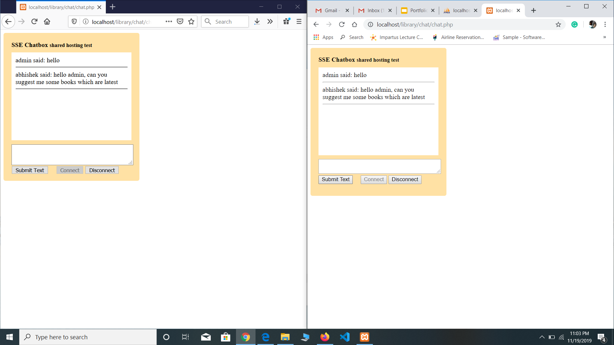
Reverse Ajax
Server Sent Events (SSE)
We used server sent events to synchronously update the change in event happening.
Once we press on connect the user is ready to chat with other user or admin for any queries.
Once the connection is established until one of the users disconnects the link both can continue their chat.

Slide 7
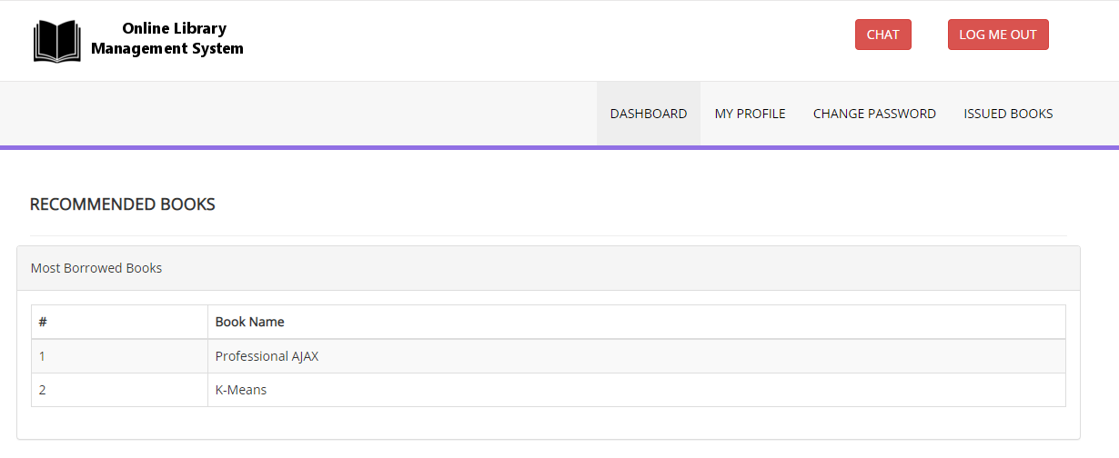


INTELLIGENT COMPONENT
We have put recommendation system as our
Intelligent component.
Algorithm used for recommendation system is
FP Growth.
The books for each user are recommended using their previous book which have been borrowed.

Slide 8

Thank YOU!!!!

